Slide 1
E Commerce
BCA 3RD YEAR
Unit-4
Prepared By: Mrs. Monika Anand
Assistant Professor
HIMT,ROHTAK

Slide 2
B2B- Inter Organization e-commerce
B2B- Inter Organization e-commerce
Website following the B2B business model sells its
products to an intermediate buyer who then sells
the products to the final customer. As an example, a wholesaler places an order from a company's website and after receiving the consignment, it sells the end product to the final customer who comes to buy the product at the wholesaler's retail outlet

Slide 3
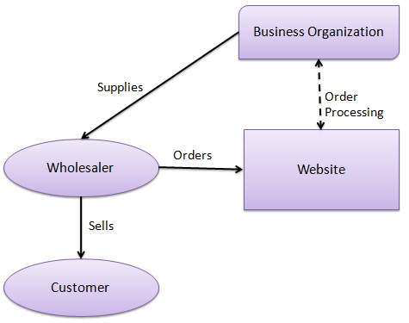

Slide 4
B2B identifies both the seller as well as the buyer as business
entities. B2B covers a large number of applications, which
enables business to form relationships with their distributors,
re-sellers, suppliers, etc. Following are the leading items in
B2B ecommerce.
• Electronics
• Shipping and Warehousing
• Motor Vehicles
• Petrochemicals
• Paper
• Office products
• Food
• Agriculture

Slide 5
Key Technologies
• Electronic Data Interchange (EDI) − EDI is an inter organizational
exchange of business documents in a
structured and machine process able format.
• Internet − Internet represents the World Wide Web or the
network of networks connecting computers across the world.
• Intranet − Intranet represents a dedicated network of
computers within a single organization.
• Extranet − Extranet represents a network where the outside
business partners, suppliers, or customers can have a limited
access to a portion of enterprise intranet/network.
• Back-End Information System Integration − Back-end
information systems are database management systems used
to manage the business data.

Slide 6
Architectural Models
Following are the architectural models in B2B ecommerce
−
• Supplier Oriented marketplace − In this type of
model, a common marketplace provided by supplier is
used by both individual customers as well as business
users. A supplier offers an e-stores for sales promotion.
• Buyer Oriented marketplace − In this type of model,
buyer has his/her own market place or e-market. He
invites suppliers to bid on product's catalog. A Buyer
company opens a bidding site.
• Intermediary Oriented marketplace − In this type
of model, an intermediary company runs a market place
where business buyers and sellers can transact with each
other.

Slide 7
B2C model – Intra-organizational ecommerce
In B2C model, a business website is a place
where all the transactions take place directly
between a business organization and a
consumer

Slide 8
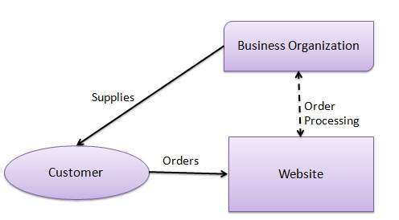

Slide 9
B2C model
In the B2C model, a consumer goes to the website,
selects a catalog, orders the catalog, and an
email is sent to the business organization. After
receiving the order, goods are dispatched to the
customer. Following are the key features of the
B2C model −
• Heavy advertising required to attract customers.
• High investments in terms of
hardware/software.
• Support or good customer care service.

Slide 10
Consumer Shopping Procedure
Following are the steps used in B2C e-commerce −
A consumer −
• determines the requirement.
• searches available items on the website meeting the
requirement.
• compares similar items for price, delivery date or any
other terms.
• places the order.
• pays the bill.
• receives the delivered item and review/inspect them.
• consults the vendor to get after service support or
returns the product if not satisfied with the delivered
product.

Slide 11
Disintermediation and Reinter mediation
In traditional commerce, there are intermediating agents like wholesalers, distributors, and retailers between the manufacturer and the consumer. In B2C websites, a manufacturer can sell its products directly to potential consumers. This process of removal of business layers responsible for intermediary functions is called disintermediation.

Slide 12
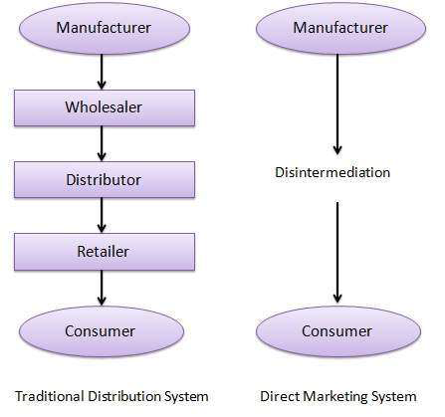

Slide 13
Nowadays, new electronic intermediary breeds
such as e-mall and product selection agents are
emerging. This process of shifting of business
layers responsible for intermediary functions
from traditional to electronic mediums is
called re-intermediation.

Slide 14
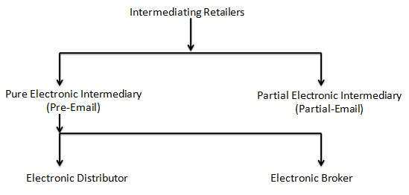

Slide 15
Ecommerce Advantages
#1: Low Financial Cost
#2: 24/7 Potential Income
#3: Sell Internationally
#4: Easy to Showcase Bestsellers
#5: Personalized Online Experience
#6: Affordable employees
#7: Easier to Encourage Impulse Buy
#8: Easy to Retarget or Remarket to Customer
#9: Customers Get a Less Invasive Experience
#10: Gain Access to Customer Data Easily
#11: Able to Process a High Number of Orders
#12: Can Scale Business Quickly
# 13: Can Grow Business Organically with Content

Slide 16
Disadvantages
#1: No One Can Buy During a Site Crash
#2: Customers Can’t Try Before They Buy
#3: Ecommerce Is Highly Competitive
#4: Customers Can Be Impatient
#5: You Need To Ship Your Products
#6: Physical Retail is Still More Popular
Despite Decline

Slide 17
ELECTRONIC PAYMENT SYSTEMS
E-payment or Electronic payment is any digital financial payment transaction involving currency transfer between two or more parties
Implementation of electronic payment systems is in its infancy and still evolving.
Electronic payments are far cheaper than the traditional method of mailing out paper invoices and then processing payments received.

Slide 18
Types
Payment Cards
Electronic Cash
Internet Cash
Wallet
Smart Card

Slide 19
ELECTRONIC CASH
Electronic cash is a general term that describes the attempts of several companies to create a value storage and exchange system that operates online in much the same way that government-issued currency operates in the physical world.  Concerns about electronic payment methods include:
• Privacy • Security • Independence • Portability

Slide 20
ELECTRONIC WALLETS
An electronic wallet serves a function similar to a physical wallet:
• holds credit cards, electronic cash, owner identification, and owner contact information • provides owner contact information at an electronic commerce site’s checkout counter Some electronic wallets contain an address book

Slide 21
What is EDI?
Electronic Data Interchange (EDI) is the computer-to-computer exchange of business documents in a standard electronic format between business partners.
By moving from a paper-based exchange of business document to one that is electronic, businesses enjoy major benefits such as reduced cost, increased processing speed, reduced errors , improved relationships with business partners.

Slide 22
Computer-to-computer– EDI replaces postal mail, fax and email. While email is also an electronic approach, the documents exchanged via email must still be handled by people rather than computers.
Having people involved slows down the processing of the documents and also introduces errors. Instead, EDI documents can flow straight through to the appropriate application on the receiver’s computer (e.g., the Order Management System) and processing can begin immediately

Slide 23
Business documents
These are any of the documents that are typically exchanged between businesses. The most common documents exchanged via EDI are purchase orders, invoices and advance ship notices. But there are many, many others such as bill of lading, customs documents, inventory documents, shipping status documents and payment documents.

Slide 24
Standard format
Because EDI documents must be processed by computers rather than humans, a standard format must be used so that the computer will be able to read and understand the documents. A standard format describes what each piece of information is and in what format (e.g., integer, decimal, mmddyy).

Slide 25
Business partners
The exchange of EDI documents is typically between two different companies, referred to as business partners or trading partners. For example, Company A may buy goods from Company B. Company A sends orders to Company B. Company A and Company B are business partners.

Slide 26
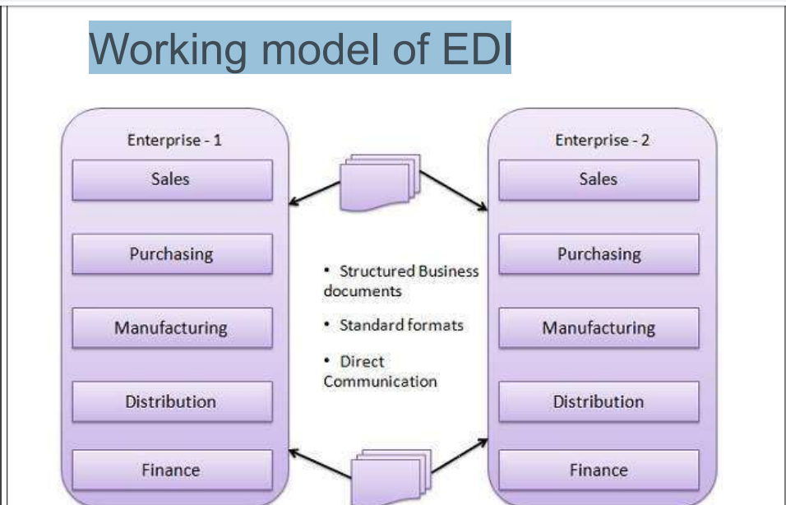
Working model of EDI

Slide 27
EDI Documents
Following are the few important documents used in EDI −
Invoices
Purchase orders
Shipping Requests
Acknowledgement
Business Correspondence letters
Financial information letters

Slide 28
Steps in an EDI System
Following are the steps in an EDI System.
A program generates a file that contains the processed document.
The document is converted into an agreed standard format.
The file containing the document is sent electronically on the network.
The trading partner receives the file.
An acknowledgement document is generated and sent to the originating organization.

Slide 29
Advantages of an EDI System
Reduction in data entry errors. − Chances of errors are much less while using a computer for data entry.
Shorter processing life cycle − Orders can be processed as soon as they are entered into the system. It reduces the processing time of the transfer documents.
Electronic form of data − It is quite easy to transfer or share the data, as it is present in electronic format.
Reduction in paperwork − As a lot of paper documents are replaced with electronic documents, there is a huge reduction in paperwork.
Cost Effective − As time is saved and orders are processed very effectively, EDI proves to be highly cost effective.
Standard Means of communication − EDI enforces standards on the content of data and its format which leads to clearer communication.

Slide 30
Disadvantages of EDI
1) Expensive Setup and maintenance of some of the formats of EDI is expensive.
2) Initial setup is time consuming Initial cost to setup EDI is time consuming.
3) EDI standard changes The business process depends on EDI standard format. If any of the standard format changes then the business process has to be changed accordingly.
4) System electronic protection An EDI enabled system needs electronic protection from viruses, hacking, malware and other frauds.
5) Staff training cost Staff needs training in order to run EDI enabled software. Investment has to be done in training.
6) Proper backup should be maintained as the whole data depends on EDI. In case of any crash of EDI system, proper backup has to be maintained and extra cost is required for it.
7) Limit your trading partners Some organization stops doing business which don’t use EDI. For instance, Wal-Mart prefers to do business only with those organization which uses EDI.

Slide 31
THANKS

